Slide 1


Becoming
Full Stack
Engineer
An event for women by women

Slide 2


2. CSS
Presented by
Iliana Carrasquedo

Slide 3
Properties:
▸ Color
▸ Font-family
▸ Font-size
▸ Font-style
▸ Width
▸ Height
▸ Background
▸ Position
▸ Margin
▸ Display
▸ Padding
Definition
CSS stands for Cascading Style Sheets
and provides HTML with layout and
design. Along with making things
pretty and aesthetically pleasing, CSS
also provides a general structure to
HTML.

Slide 4
CSS conventions
CSS conventions can be broadly broken
down into two key areas: coding style
and naming conventions.
Multi-line CSS
Ordering declarations
Naming conventions

Slide 5
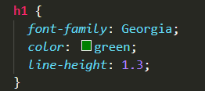
Multi-line CSS
Ordering declarations
1. Position
2. Display and box model
3. Font and typography
4. Color
5. Background and
borders

Slide 6
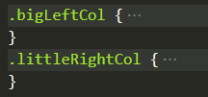



Naming Conventions
Subtitle here
Naming conventions in CSS, refers to class or ID names as opposed to the name of a file.
Class names should be descriptive and semantic, they should describe your content and not the presentation.

Slide 7
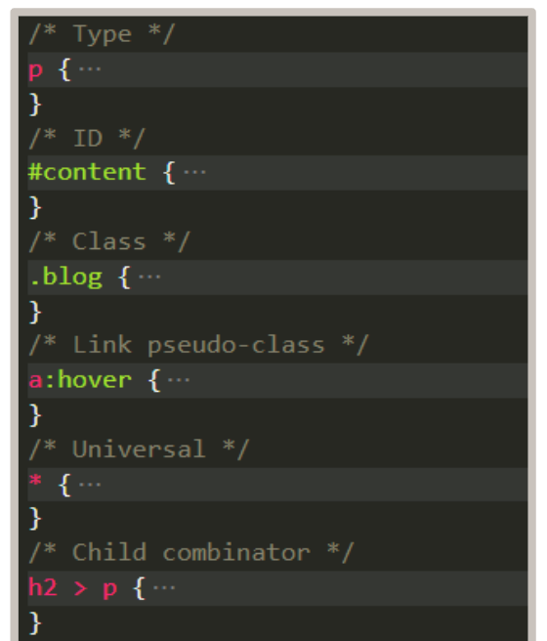
CSS Selectors
Using selectors, we can target elements at an even more granular level than we’ve been able to previously.
This means that the markup can be super slim, semantic, and flexible.
What’s more, the element states pseudo-classes allow for additional highlighting of dynamic state changes.

Slide 8




CSS Combinators
General sibling combinator. When using the general sibling combinator, the second selector doesn’t have to immediately follow the first; however, both parts of the selector must still share the same parent.
Descendant combinators allow you to target all instances of a single element type that lie within another.
Child combinators, in contrast, target only those elements that are immediate children of the parent
Adjacent sibling combinators, targets elements that are next to each other in the document tree and have the same parent.

Slide 9
@charset: Defines the character set used by the style sheet.
@import: Tells the CSS engine that it includes an external style sheet
@media: A conditional rule that will apply if the device meets the criteria.
@keyframes: Describes step configuration in CSS animation.
CSS At-rules
An at-rule is a CSS declaration that begins with the at symbol, '@', followed by an identifier, and includes all content up to the following semicolon, ';'

Slide 10
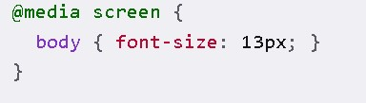
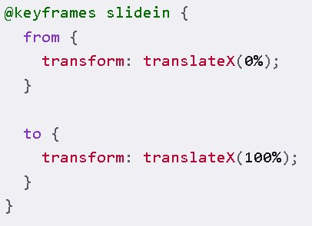
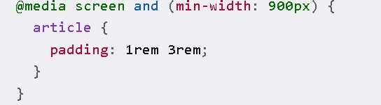
CSS At-rules
@import:
@media:
@keyframes:

Slide 11
CSS Variables
You assign a commonly used value to a variable in one place, then use the variable in your CSS in place of the value. If you need to change the value, you only need to change the variable definition.
Global Scope
Sintax
Advantages.
The :root selector matches the document root element.
:root {
--blue: #1e90ff;
--white: #ffffff;
}
The var() function is used to insert the value of a CSS variable.
color: var(--blue);
makes the code easier to read (more understandable)
makes it much easier to change the color values

Slide 12




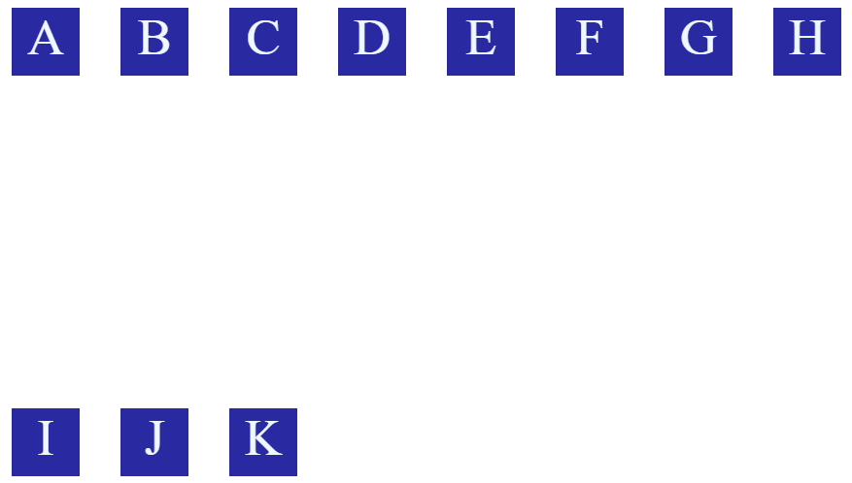


CSS Flexbox
The CSS flex property is a summary property that indicates the ability of a flexible element to alter its dimensions and fill the available space.
Flex-direction
Flex-wrap
Justify-content
Align-items
Align-content
Column
Column-reverse
Wrap
Wrap-reverse
row
row-reverse

Slide 13
Responsive Design
Responsive web design is an approach that allows design across various devices (mobile, desktop, tablet, etc.) and suggests design should respond to the user’s behavior based on screen size, platform and orientation.
More information about responsive design:
Responsive Web Design Certification | freeCodeCamp.org

Slide 14
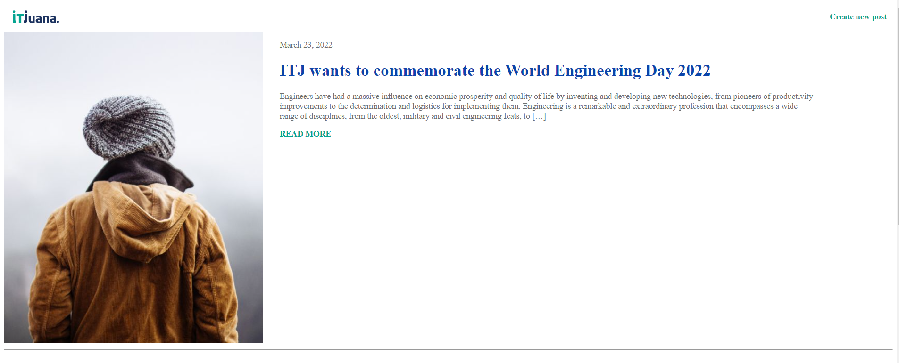
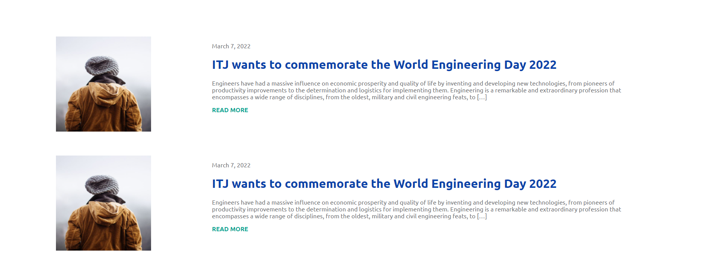
Blog Page

Slide 15

Exercise

Slide 16


Thank You
Any questions?
You can find me at carrasquedo.279@gmail.com

